Slide 1

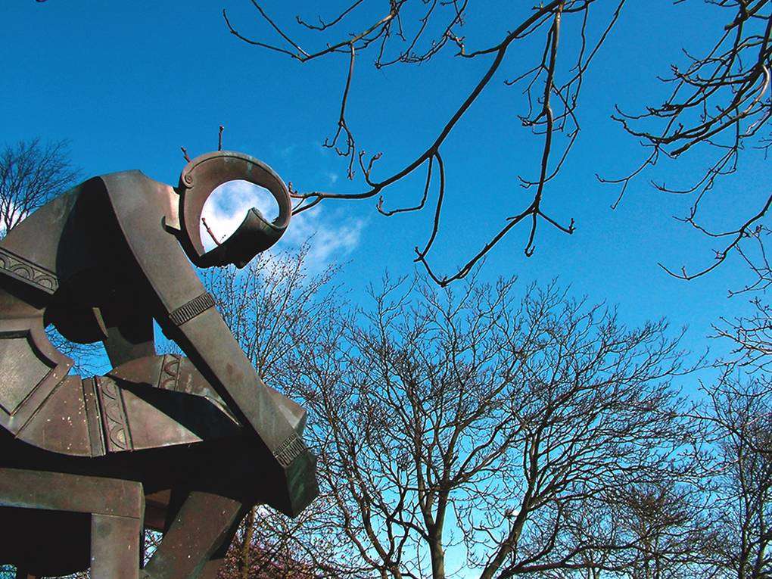
Research Data Management Project Gio Lusignani, Director of IT Simon Bevan, Director of Library Services

Slide 2
University Policy for Research Data
Compliance with RCUK, especially EPSRC by May 2015
Research proposals to include data collection, storage, on-going preservation/ management and totals support costs fully accounted
Subject metadata to be recorded and made available to other researchers
Researchers to manage the data to ensure it is fit for the life of the project
Use of University IT storage and research systems
Data sharing plan to consider IPR, etc

Slide 3
RDM project
Project team setup to define processes and systems
Reps from key Schools and support functions
Data audit to identify storage requirements
Current grant proposal processes documented for one school in order to understand how they need to be developed
Review of published data and best practices (e.g. collaborative projects)
Possible development of Dspace system for managing published data
Understand what support can be provided to researchers (e.g. information on intranet, data curation)

Slide 4
Project team
Steve Hallett, SAS
Chris Thompson, SoE
Seamus Higson, CRH
Anne Knight/John Harrington (Library), Ed Poll/Gary Dooley (IT) and Ian Sibbald (Finance)
Project leads: Gio Lusignani & Simon Bevan

